Slide 1
Sympathetic and Parasympathetic Nervous System

Slide 2
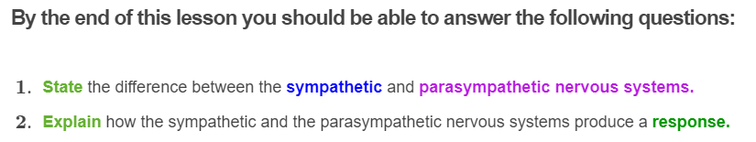



Slide 3
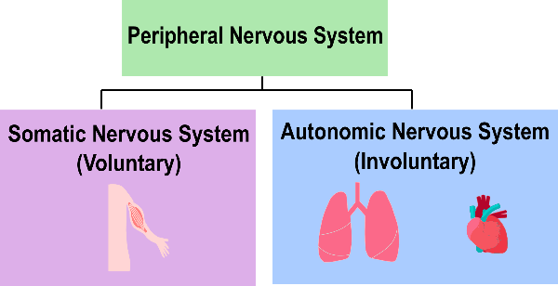
In the previous Smart Lesson we learnt that the peripheral nervous system can be divided up into the autonomic and somatic nervous system.
While the somatic nervous system is involved in voluntary movement of your skeletal muscles, the autonomic nervous system is involved in involuntary movements, and regulates the functions of your internal organs, like the heart, lungs, and involuntary muscles.

Slide 4
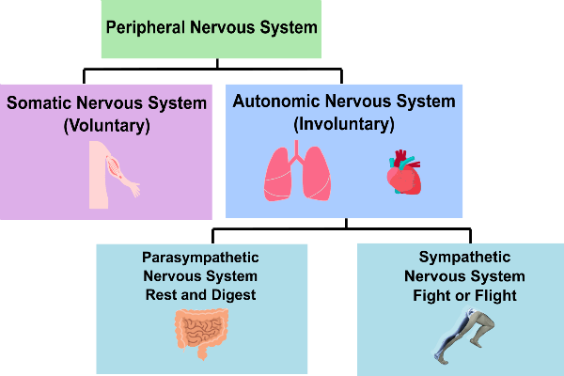
The sympathetic and parasympathetic nervous system are both part of the autonomic branch of the peripheral nervous system.
The sympathetic and parasympathetic nervous system get turned on and off as you face different situations.
For example, when you are relaxing after eating a meal and digesting that food you just ate, your parasympathetic nervous system is in control. On the other hand, when you are feeling stressed about that exam tomorrow, your sympathetic nervous system is in control!

Slide 5
The sympathetic and parasympathetic nervous systems are involuntary
The sympathetic and parasympathetic nervous systems are both considered as involuntary systems and while both control the same organs, glands and muscles, they have opposing effects on the target tissues.

Slide 6
You might remember from the previous Smart Lesson that in the somatic nervous system, (voluntary movement) there is only one motor neuron that goes straight from the central nervous system to the effector muscle.

Slide 7
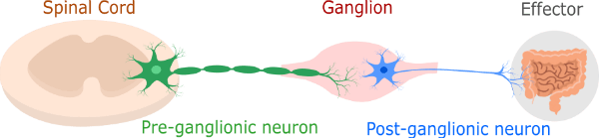
However, in the autonomic nervous system, instead of having just one neuron that goes directly from the central nervous system to the effectors, there are two different motor neurons that go from the central nervous system to the effectors.

Slide 8
The first neuron, called the preganglionic neuron, branches off from the spinal cord to a ganglion (a mass of nerve tissue that contains groups of neurons) where it meets another neuron, called the postganglionic neuron.
The postganglionic neuron goes from the ganglion to the effector (organ, muscle or gland).

Slide 9
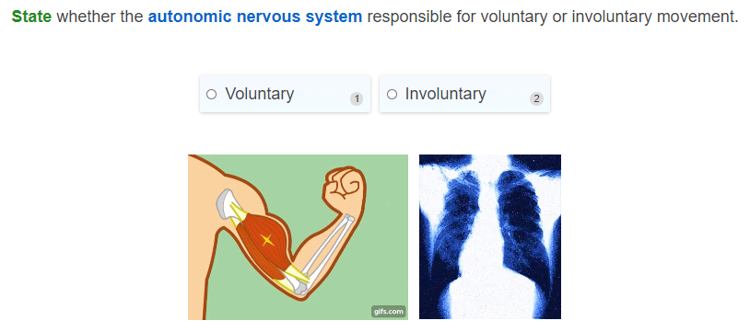

Slide 10
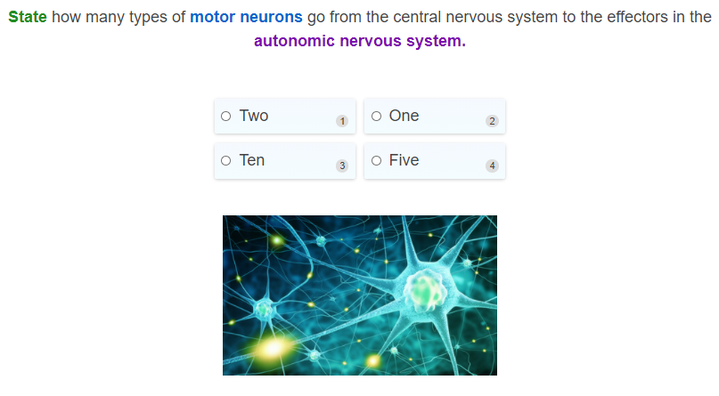

Slide 11
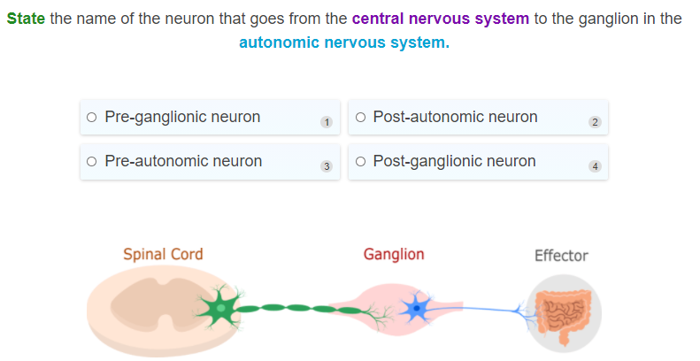

Slide 12
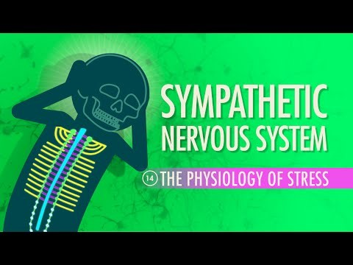

Slide 13
Sympathetic nervous system: Fight or Flight response
Although the sympathetic nervous system sounds like the type of pathway that keeps your body calm and relaxed, it in fact, does the complete opposite!
The sympathetic nervous system activates the 'fight or flight' response of your body when you are stressed. This includes physically, mentally and environmentally stressful situations.
Think sympathetic = stressed
Lots of different body functions are affected while your body prepares to face the danger or the stress it is confronted with.

Slide 14
Example of the sympathetic nervous system in action
Imagine if there is a fire in the building. The smoke alarm goes off and immediately, you start to panic and feel stressed.
Without even thinking about it, your body has activated the sympathetic nervous system.
A signal gets sent from central nervous system through the pre-ganglionic motor neuron and passes through to the ganglia, where it releases a neurotransmitter (a chemical message that gets released at end of a neuron) called acetylcholine across the synaptic cleft.

Slide 15
The neuron that receives the signal is the post-ganglionic neuron, which then takes this information from the ganglion to the effectors.
The post-ganglionic neurons then release the neurotransmitter noradrenaline at the effectors, and result in a response!

Slide 16

There are a lot of responses when the sympathetic nervous system is activated!
Here are some of the many responses that are seen when the sympathetic nervous system is activated:
• | Increase in heart rate
• | Increase in air intake by lungs
• | Pupils of eyes are dilated (get larger)
• | Inhibits (or slows down) digestion
These responses all go toward helping you face stress, so you can get away from that building on fire as quickly as you can.

Slide 17
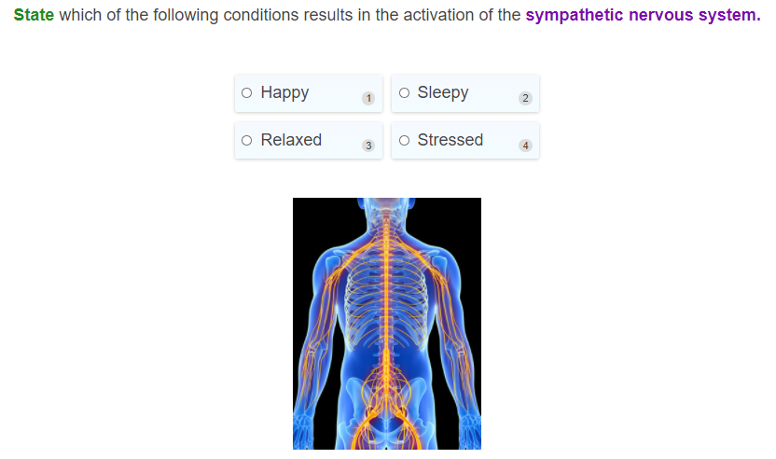

Slide 18
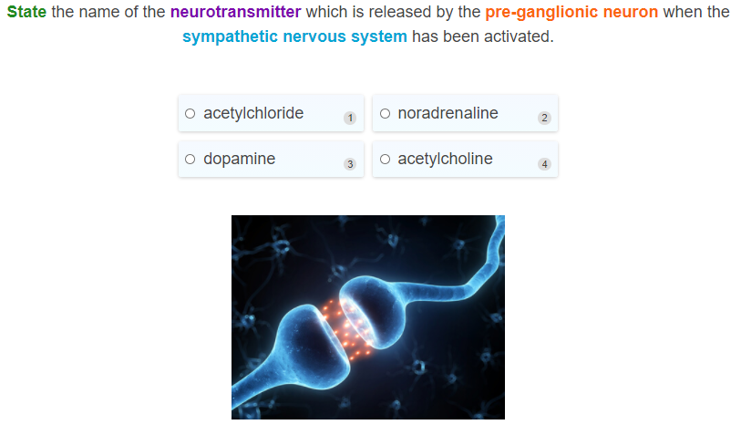

Slide 19
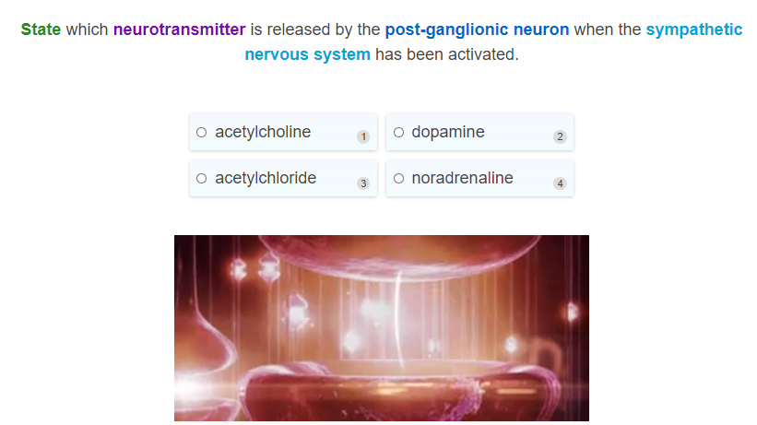

Slide 20
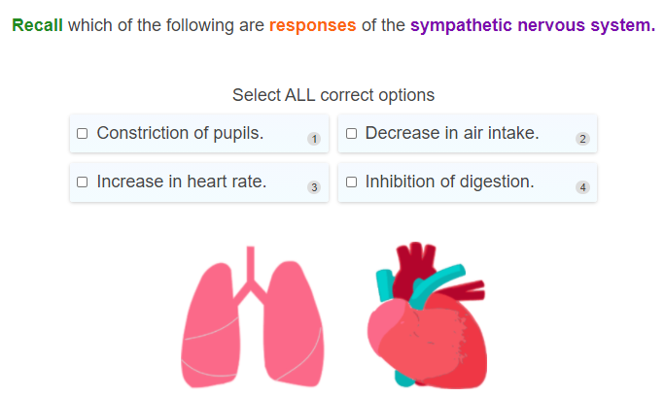

Slide 21

Sympathetic nervous system vs parasympathetic nervous system
While the sympathetic nervous system gears you up to face stressful situations, the parasympathetic system calms your body down and is very important at regulating your normal bodily functions, allowing you to digest food, relax, and excrete waste to name a few.
The parasympathetic nervous system activates a 'rest and digest' response. This means that it calms your body down after you've run out of that burning building and causes your body to go back into a normal resting state, so that you can relax and digest the food you ate for lunch.

Slide 22
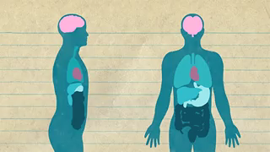
The parasympathetic nervous system is in control most of the time
Since the parasympathetic nervous system is typically involved in the regulation of our normal bodily functions, the parasympathetic nervous system is usually in control most of the time rather than the sympathetic nervous system.
This makes sense since we wouldn't want to be constantly in a state of 'fight or flight'!

Slide 23
When you've run out of that building that was on fire, you stop feeling stressed and calm down.
This is when the parasympathetic nervous system starts to kick in.
Like the sympathetic nervous system, a signal gets sent from the central nervous system through the preganglionic motor neuron and passes through to the ganglion, where it releases the neurotransmitter acetylcholine across the synaptic cleft.
This is the same neurotransmitter that was also released at the preganglionic neuron of the sympathetic nervous system!

Slide 24
When the postganglionic neuron receives the signal it then transmits the signal to the effectors.
Unlike the sympathetic nervous system, the parasympathetic postganglionic neurons release acetylcholine as a neurotransmitter at the effectors, and result in a response!

Slide 25

Activation of the parasympathetic nervous system results in:
• | Decrease in heart rate
• | Decrease in air intake by lungs
• | Pupils of eyes are constricted (get smaller)
• | The muscles involved in digestion are relaxed
• | There is an increase in intestinal activity

Slide 26
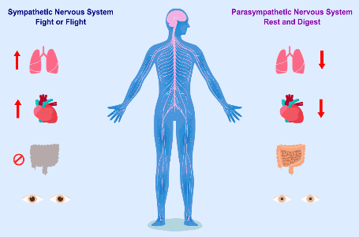
It is very important for the sympathetic and parasympathetic nervous system to work together in order to maintain homeostasis of the body and keep the balance within the body.
When you are stressed, your sympathetic nervous system is in control. Your heart rate increases, air intake is increased and other body functions, like digestion, are inhibited while you deal with the situation at hand.
However, once the situation is dealt with, your body should then restore you back to the normal resting state so that the parasympathetic nervous system is back in control. Your heart rate goes back down to normal, and your other body functions resume.

Slide 27

Since the parasympathetic nervous system is important in keeping your body relaxed and maintaining normal bodily functions, it should be in control most of the time.
When the sympathetic nervous system is in control, digestion is shut down, and other important body systems are inhibited.
Our bodies are not meant to stay in this state for a very long time since it can be damaging for our bodies.

Slide 28

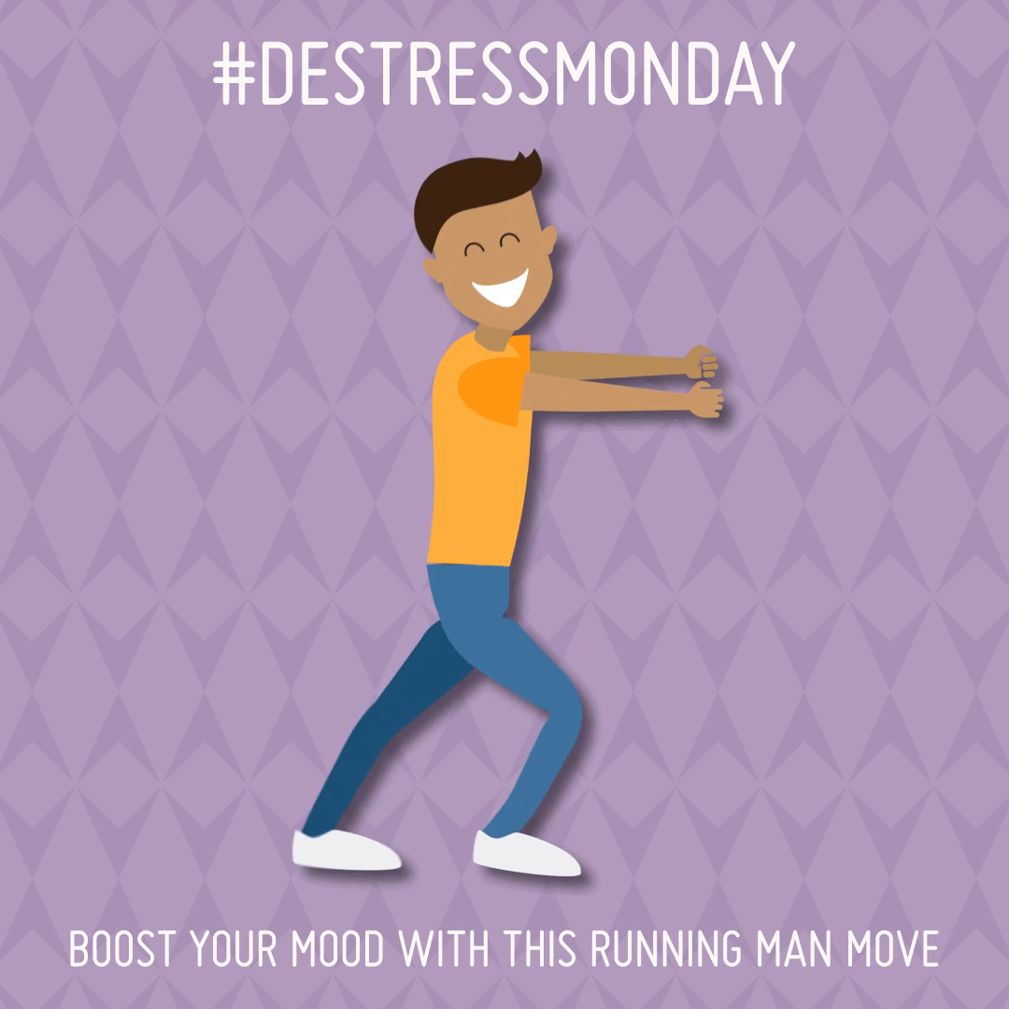
During periods of constant stress, the parasympathetic nervous system is rarely getting activated to restore the body back to a normal resting state.
As a result of the sympathetic nervous system being constantly activated, your body will feel tired, food cannot be digested as efficiently, and other bodily functions can become impaired, which can lead to damaging effects on health.
Therefore, it is important to try and reduce stress so that our body spends as little time in sympathetic mode as possible!

Slide 29
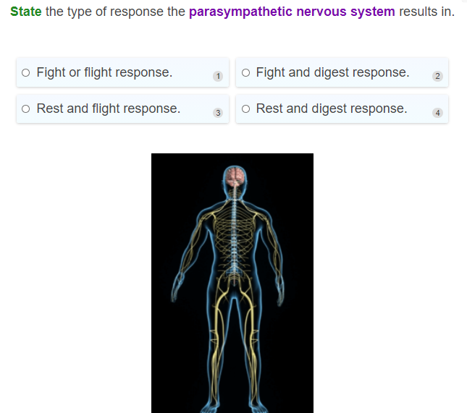

Slide 30
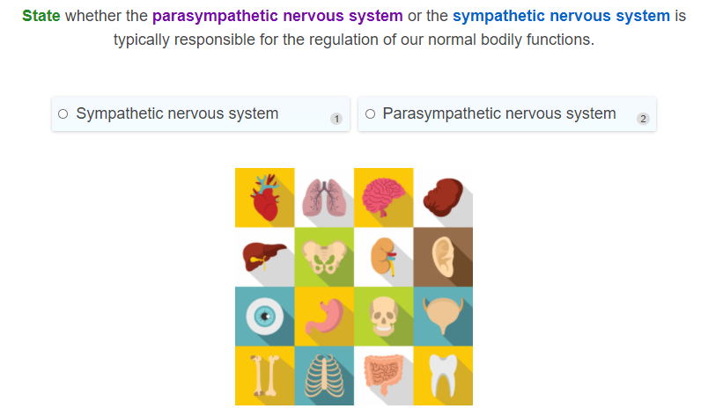

Slide 31
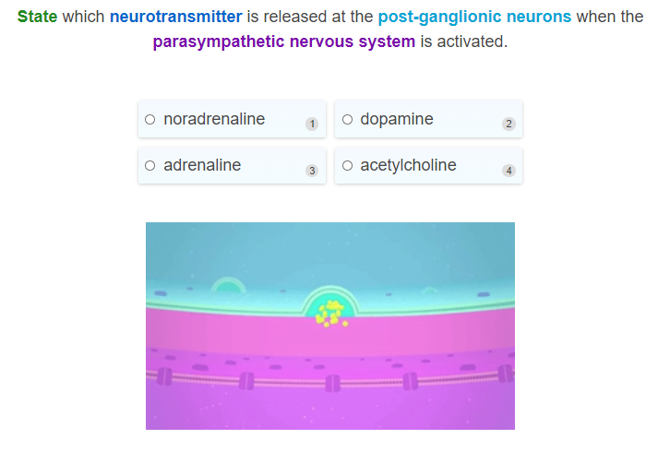

Slide 32
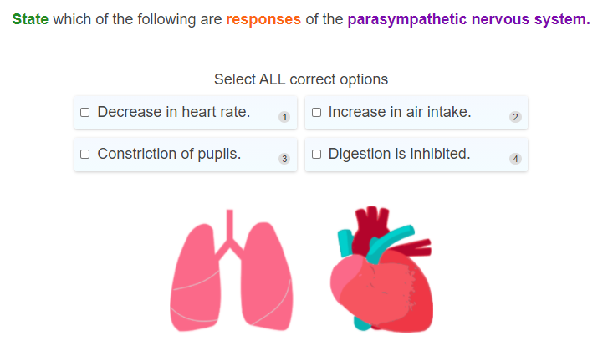

Slide 33
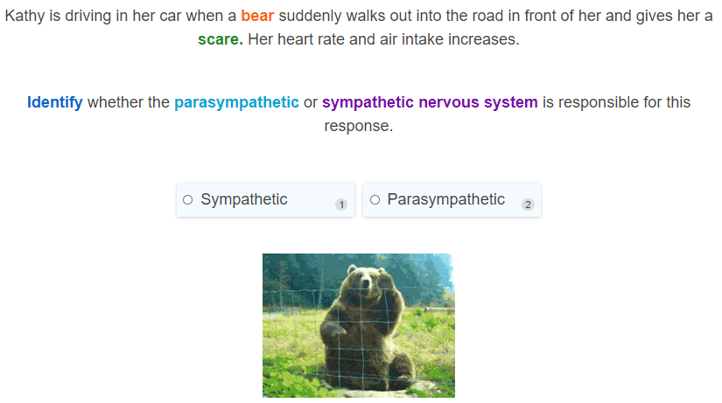

Slide 34
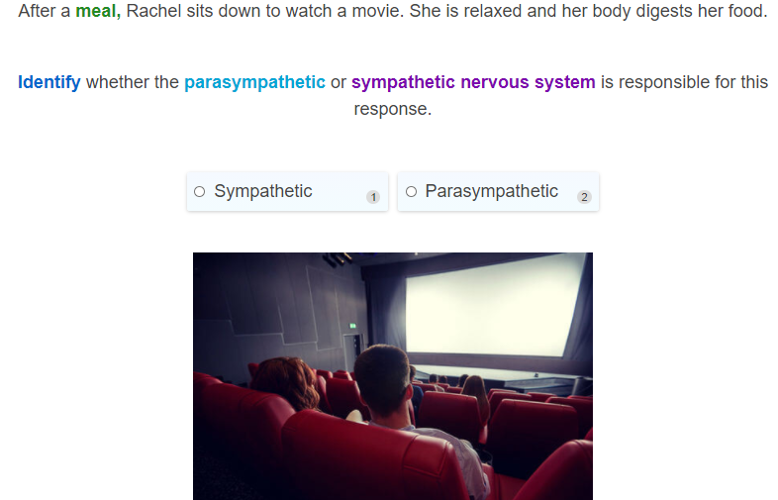

Slide 35
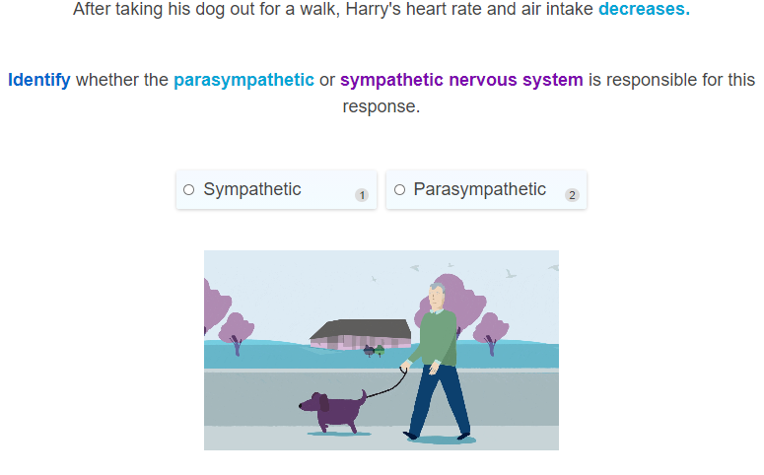

Slide 36
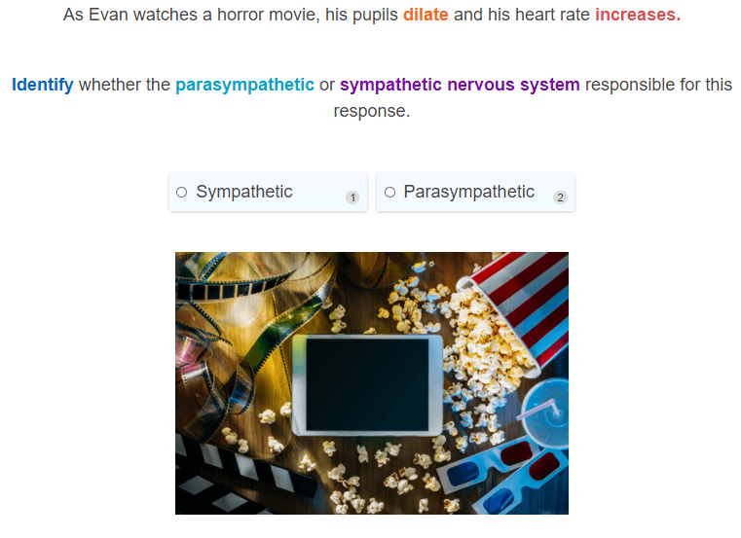

Slide 37
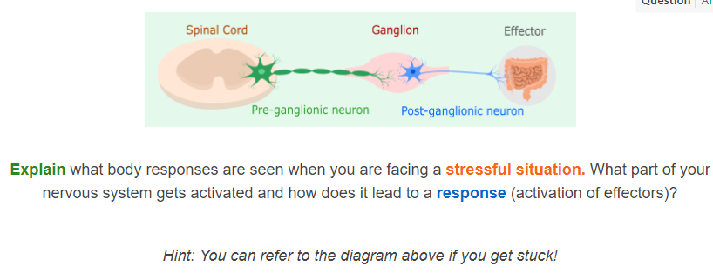

Slide 38
